Slide 1
Shepherd
LIVESTOCK MONITORING WITH AI
Team Norse:

Slide 2
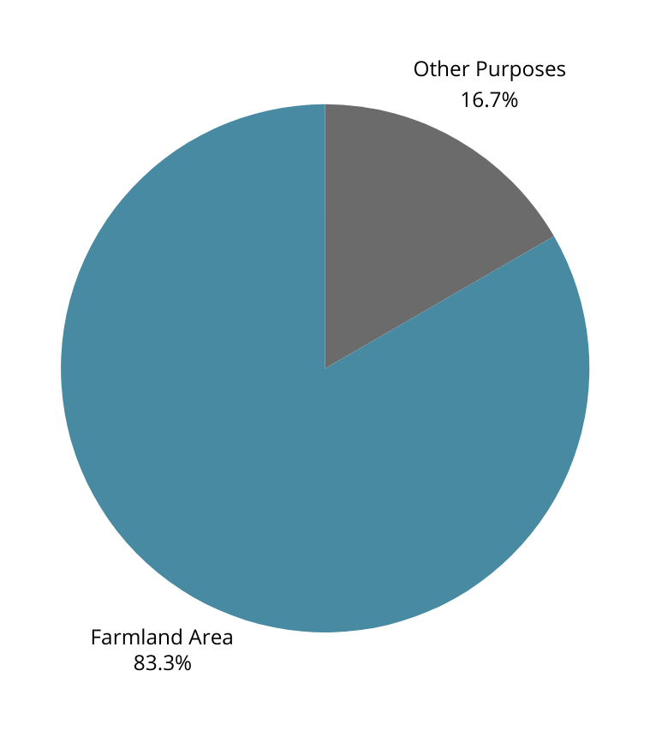
Iowa GDP Breakdown (2023)
Agriculture accounts for around sixteen billion dollars of Iowa’s GDP!
https://www.nass.usda.gov/Statistics_by_State/Iowa/Publications/Other_Surveys/2024/IA-Farms-02-24.pdfph text

Slide 3
Introduction to Livestock
Monitoring is crucial, as low movement indicates an animal might be sick
Manually monitoring cameras is time-consuming
This presents a need and an untapped source of data
Many farmers use cameras to monitor livestock
Many farmers are unable to regularly monitor

Slide 4
Imagine you are a farmer...

Slide 5
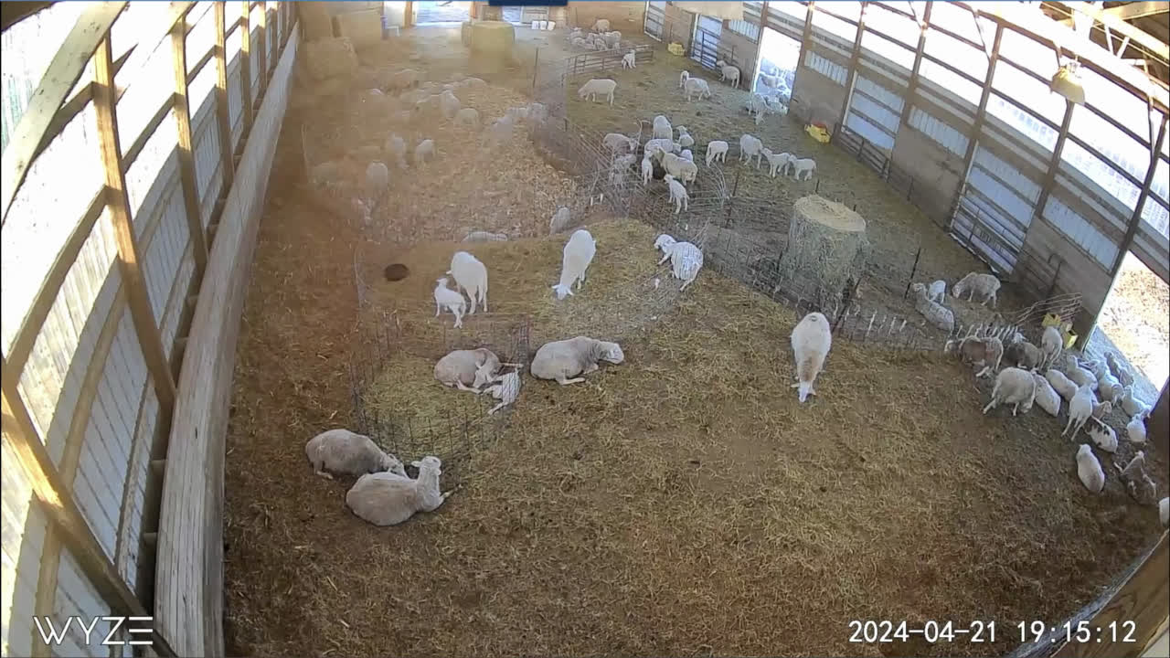
Tired of counting sheep yet?
What about now?
Now? ...

Slide 6
Wouldn’t it be nice if...
1
2
3
Input: Surveillance video of local sheep farm
Output: Distance traveled of sheep
Enjoy a cup of coffee & peace of mind

Slide 7
 | Human Labour | Traditional Computer Algorithms | Machine Learning/ AI
Time | Time Consuming | Not available | Less Consuming
Cost | Expensive | Not available | Less Expensive
Real-time monitor | Cannot achieve | Not available | Possible
Adaptability | Easily Adapt | Not available | Efficient Adaptation
Scalability | Very Challenging | Not available | Very Scalable

Slide 8

YOLOv8
Out of a variety of models for object detection, our team choose YOLO for its simple architecture and capability to perform real-time monitoring

Slide 9
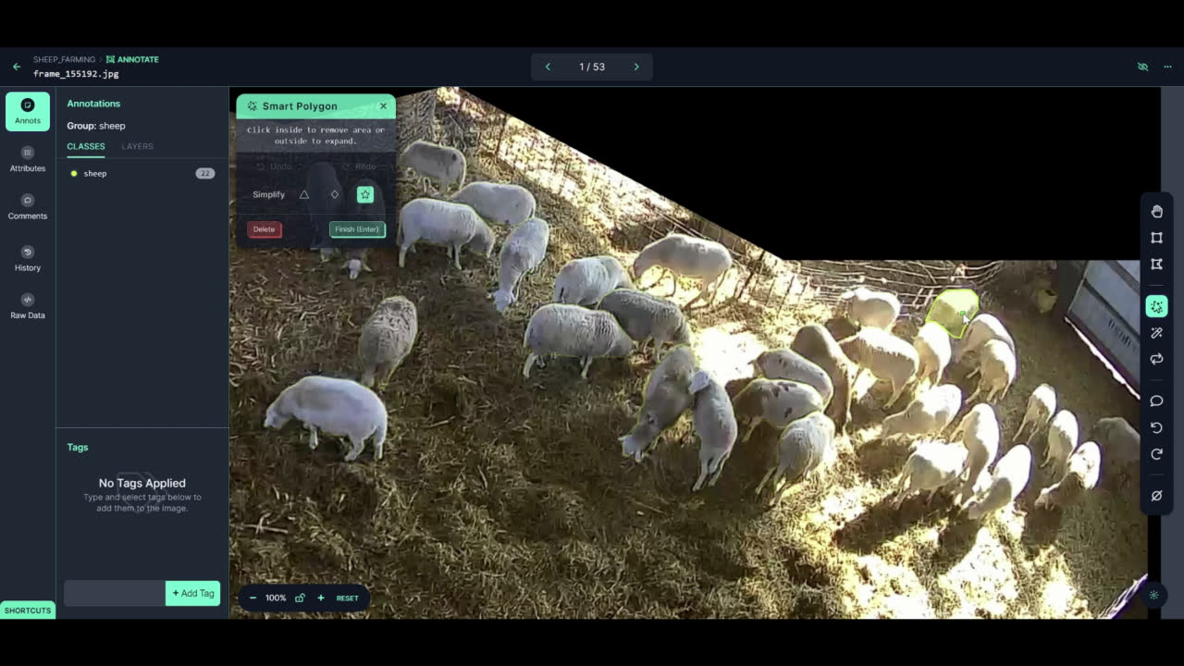
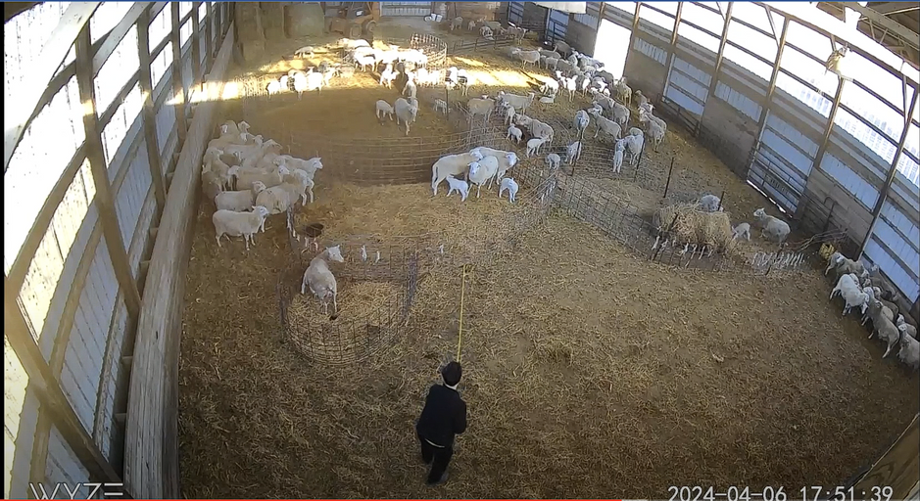
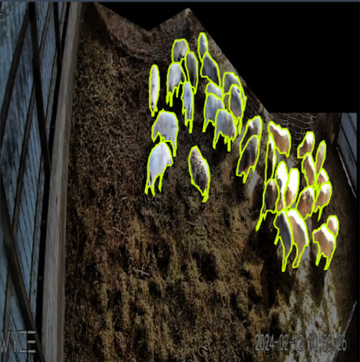
Machine Learning Pipeline
Data Collection and Preparation
Measurement
Augmentation
Our team traveled on site to collect distances which could be translated into travel output from our model
We transformed our annotated images to improve the generalization ability of our model
Video/Frames
Annotation
Our team recorded hours of sheep surveillance footage and broke that into many frames
Across our team, we spent a many labeling sheep using the tools on Roboflow, which we used to train our model

Slide 10
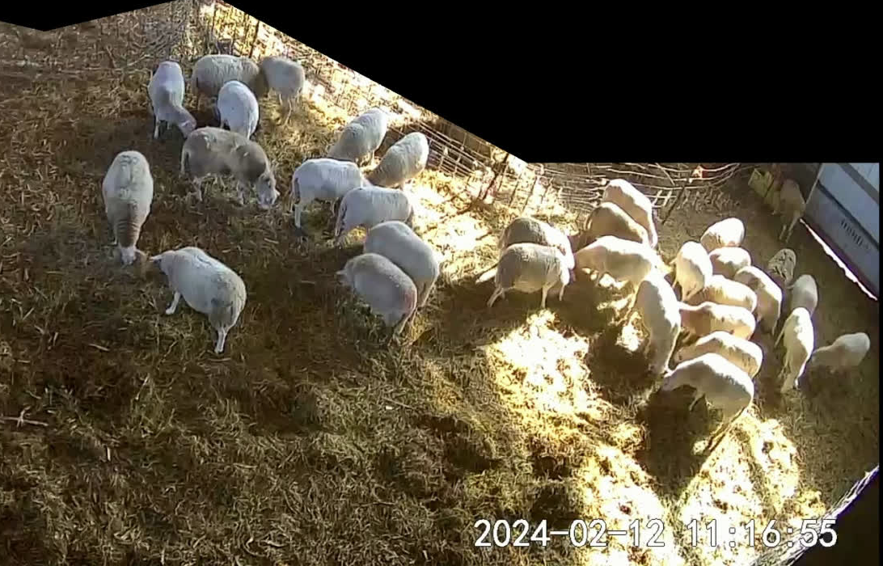
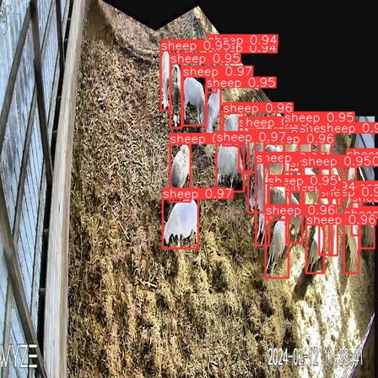
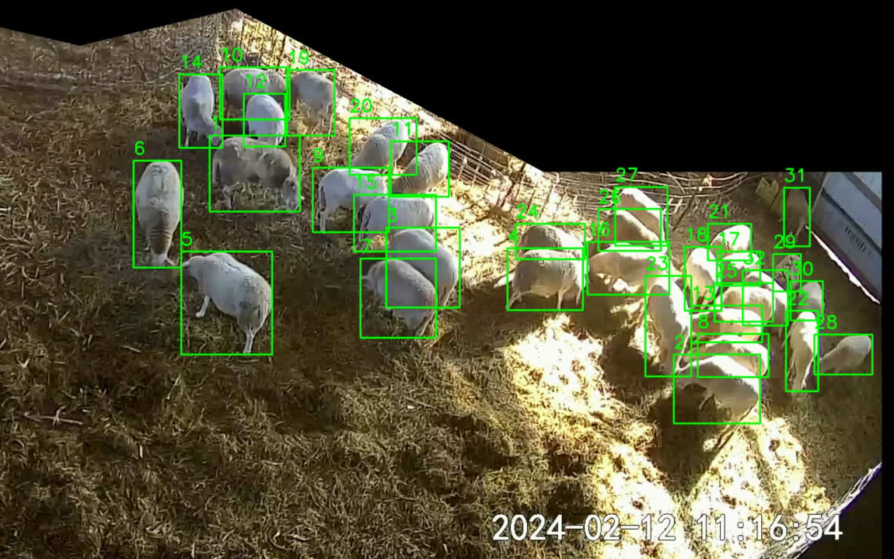

Machine Learning Pipeline
Tracking Sheep and Calculating Distances
Our fine-tuned YOLOv8 model
Our Custom Object tracking algorithm
Our Distance Calculating formula
Input video
Object Detection
Tracked Objects
Distances

Slide 11
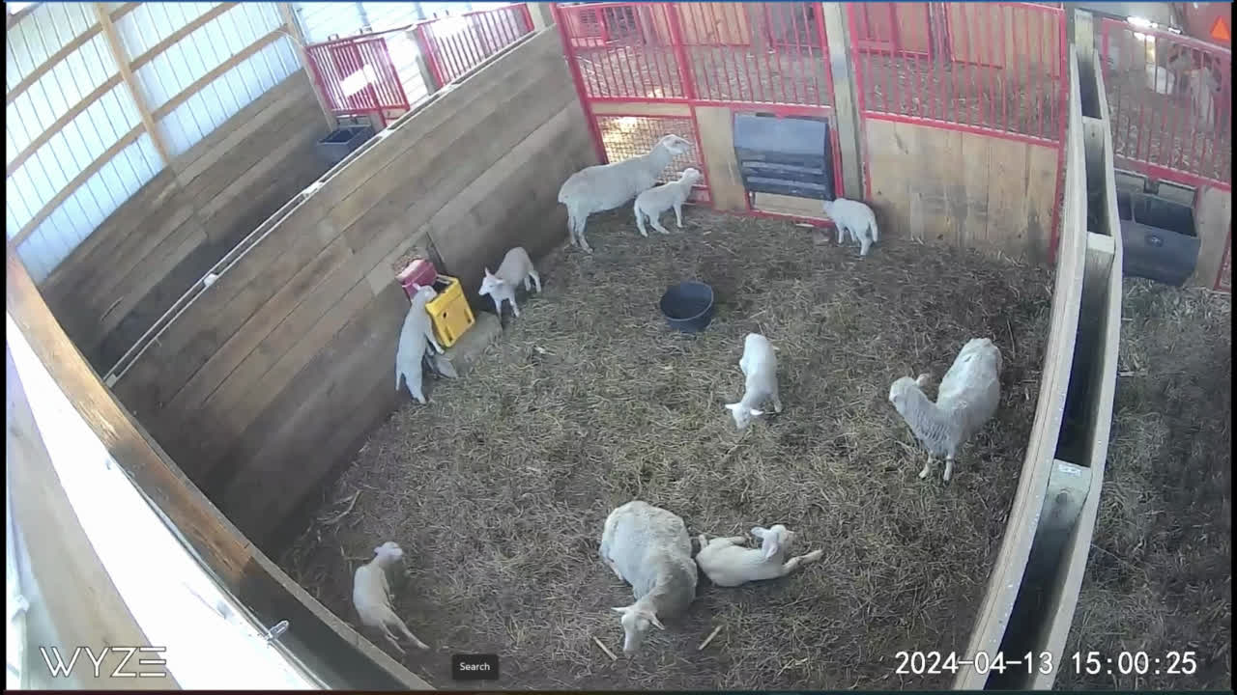
Products Comparison
Movement detection with existing commercial product
Our object tracking with distance calculation
Yes, the product is “detecting”

Slide 12
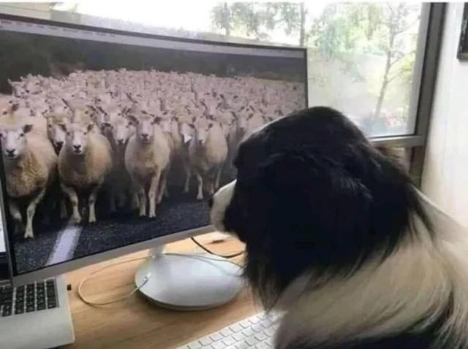
Ethical Considerations
More data and more cameras allow us to make a more accurate model without needing to confine animals to smaller spaces. (Meeting communities where they are)
Potential errors in our model can be minimized with the expertise of farmers. (We provide information, not decisions)
Our solution avoid replacing existing labor. Instead it acts as a compliment to existing farmers! (And helps livestock stay healthy!)

Slide 13

Feasibility
1
2
3
We have successfully implemented our AI solution using existing technology
Our model is cost effective
Potential market:
Business to Business
Business to Consumer

Slide 14
IMPACT POTENTIAL
Improve Productivity
GLOBE
Final product would serve to lessen the requirements of a labor-intensive industry, Making even small improvements in such a large space leads to massive benefits!
Machine Learning Adoption
USA
Our product stands to offer a machine learning solution to a community who have large demands, but can be underserved.
Scalability
While our solution was initially targeted within our community, it can easily be expanded to help people from many communities all over the world!
IOWA

Slide 15
Web App
Simple but powerful!

Slide 16
No sheeps or farmers are harmed in this process
Questions?

